Slide 1
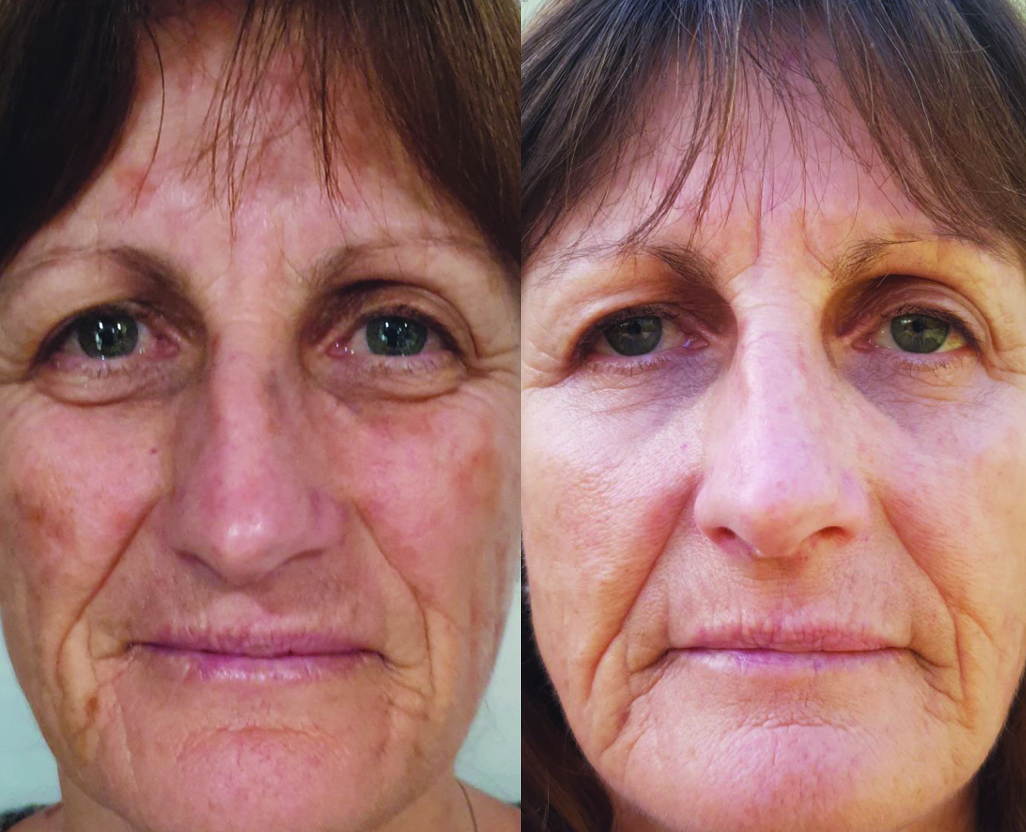
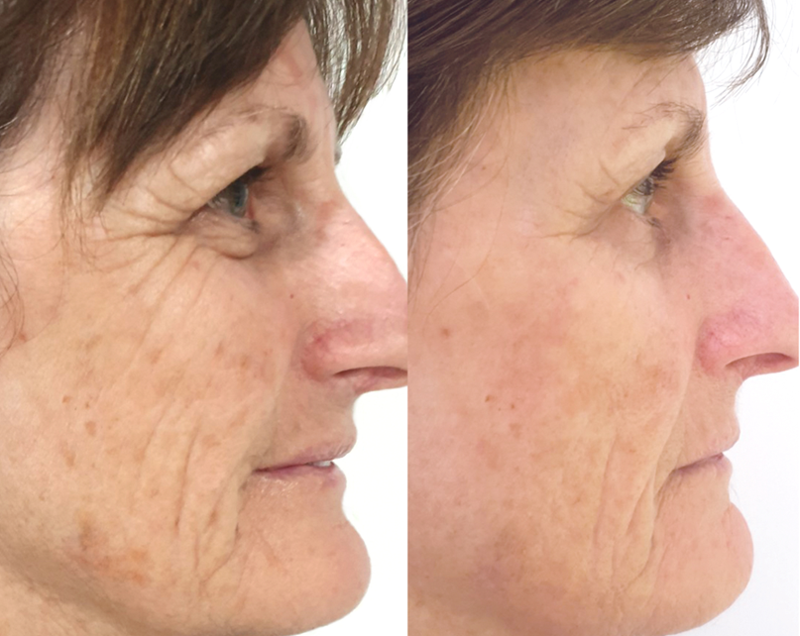
SEE THE RESULTS
skin description: sun damage + pigmentation
treatment: nightly application of asap liquid platinum for 8 weeks
result: massive improvement in skin hydration and lightening of pigmentation
BEFORE
AFTER 8 WEEKS

